Slide 1
Thursday, January 26, 2017
Write In Your Agenda:
Write In Your Monitoring Log:
CW:
A New Critter & Its Niche
Ecology Crossword Puzzle
HW:
Finish Ecology Crossword Puzzle
Study for Ecology Quiz on Monday, January 30.
Response to Warm-Up:
Describe your niche in your environment.
You will need:
Pencil.

Slide 2
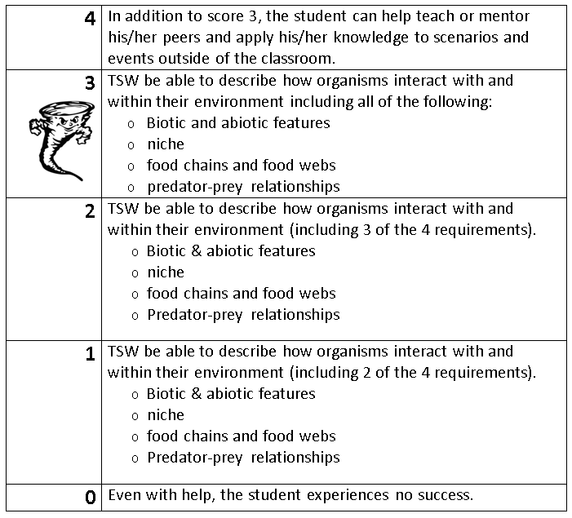
Learning Goal and Scale
TSW be able to describe how organisms interact with and within their environment (including biotic and abiotic features, niche, food chains & webs, and predator-prey relationships).

